Slide 1
Parkinson’s Disease Prediction

Slide 2
Objective:
The main aim of this article is to understand what is Parkinson’s disease and to detect the early onset of the disease.
Various algorithms like XGBoost Algorithm is employed in order to predict the disease.

Slide 3
Parkinson’s Disease
It is a brain neurological disorder.
It leads to shaking of the body , hands and provides stiffness to the body.
No proper cure is available at the advanced stage.
Treatment is possible only when done at the early or onset of the disease.
These will not only reduce the cost of the disease but will also possibly save a life.
Most methods available can detect Parkinson in an advanced stage.

Slide 4
Parkinson’s Disease
It means loss of approx.. 60% dopamine in basal ganglia and is responsible for controlling the movement of the body with a small amount of dopamine.
More than 145,000 people have been found alone suffering in the U.K and in India, almost one million population suffers from this disease and it’s spreading fast in the entire world.

Slide 5
Parkinson’s Disease
A person diagnosed with Parkinson’s disease will have the following symptoms:
Depression
Anxiety
Sleeping , and memory – related issues.
Loss of sense of smell along with balance problems.

Slide 6
Parkinson’s Disease
Several factors are responsible for triggering the disease:
Genes – Certain mutation genes are found by research that they are very rare.
The gene variants often increase the risk of Parkinson’s disease but have a lesser effect on each genetic marker.
Environment - Due to certain harmful toxins or chemical substances found in the environment can trigger the disease but have a lesser effect.

Slide 7
Parkinson’s Disease
Although it develops at age of 65 15% can be found at young age people less than 50. We will make use of XGBoost, KNN, SVMs, and Random Forest Algorithm to check which is the best algorithm for detection of the onset of disease.

Slide 8
XGboost
It is an algorithm.
It has recently been dominating applied gadget learning.
XGBoost set of rules is an implementation of gradient boosted choice timber.
That changed into the design for pace and overall performance.

Slide 9
Implementation
import numpy as np
import pandas as pd
import os, sys
from sklearn.preprocessing import MinMaxScaler
from xgboost import XGBClassifier
from sklearn.model_selection import train_test_split
from sklearn.metrics import accuracy_score

Slide 10
Implementation
df=pd.read_csv('parkinsons.data')
df.head()

Slide 11
Implementation
features=df.loc[:,df.columns!='status'].values[:,1:] labels=df.loc[:,'status'].values
print(labels[labels==1].shape[0], labels[labels==0].shape[0])
scaler=MinMaxScaler((-1,1))
x=scaler.fit_transform(features)
y=labels
x_train,x_test,y_train,y_test=train_test_split(x, y, test_size=0.2, random_state=7)
model=XGBClassifier(eval_metric='mlogloss')
model.fit(x_train,y_train)

Slide 12
Implementation
y_pred=model.predict(x_test)
print(accuracy_score(y_test, y_pred)*100)
from sklearn.metrics import confusion_matrix
pd.DataFrame( confusion_matrix(y_test, y_pred), columns=['Predicted Healthy', 'Predicted Parkinsons'], index=['True Healthy', 'True Parkinsons']
)

Slide 13
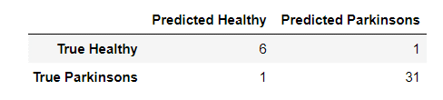
Output

Slide 14
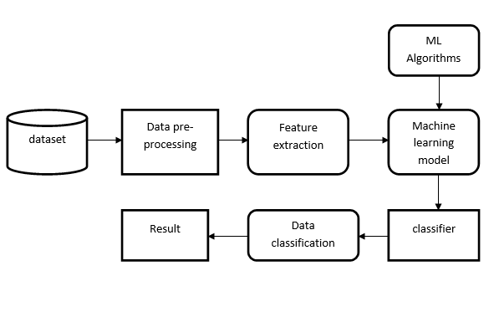
System Architecture:

Slide 15
Implementation
It shows 94% accuracy by XGBoost algorithm.
Decision trees are an exceptional device , but they can frequently over –fit the training set of facts until pruned effectively , hindering their predictive capabilities.

Slide 16
SVM – Support Vector Machine
Another algorithm for classification and regression is the support vector machine.
It is a supervised machine learning algorithm used.
Image classification and hand – written recognition are where the support vector machine algorithms are used.
It sorts the data into two categories and displays the output with margin between the two as far as possible.

Slide 17
SVM - Code
#fitting the model in SVM
from sklearn.svm import SVC
classifi2 = SVC()
classifi2.fit(x_train,y_train)
print(accuracy_score(y_test, y2_pred)*100)
y2_pred = classifi2.predict(x_test)

Slide 18
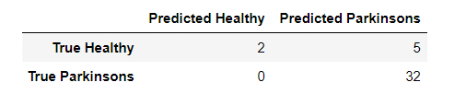
Output

Slide 19
KNN:
KNN algorithm is one of the most powerful utilized algorithms of Machine learning that is widely used for regression as well as classification tasks.
In order to predict and examine the class in which the data points fall , it examines the label of chosen data points surrounded by the target point.

Slide 20
Code
from sklearn.neighbors import KNeighborsClassifier
from sklearn.decomposition import PCA
pca = PCA(n_components = 2)
x_train = pca.fit_transform(x_train)
x_test = pca.transform(x_test)
variance = pca.explained_variance_ratio_
classifi = KNeighborsClassifier(n_neighbors = 8,p=2,metric ='minkowski')

Slide 21
Code:
from sklearn.metrics import confusion_matrix,accuracy_score
#KNN model
cm=confusion_matrix(y_test,y_pred)
accuracy_score(y_test,y_pred)

Slide 22
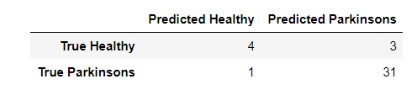
Output
Output – 0.8974358974358975

Slide 23
Random Forest
Random Forests are an ensemble version of many choice bushes.
Each tree will specialize its focus on a specific feature while it maintains a top – level view of all the capabilities.
Each tree within the random wooded area will do its own random train/check break up of the information, referred to as bootstrap aggregation and the samples no longer covered are called the ‘out-of-bag samples.
Every tree will do characteristic bagging at every node-branch split to lessen the results of a characteristic mostly correlated with the response.

Slide 24
Random Forest
While an individual tree is probably touchy to outliers, the ensemble version will no longer be the same.

Slide 25
Random Forest
X = df.drop('status', axis=1)
X = X.drop('name', axis=1)
y = df['status']
from sklearn.model_selection import train_test_split
X_train, X_test, y_train, y_test = train_test_split(X, y, random_state=1)

Slide 26
Random Forest - Code
from sklearn.ensemble import RandomForestClassifier
random_forest = RandomForestClassifier(n_estimators=30, max_depth=10, random_state=1)
random_forest.fit(x_train, y_train)
from sklearn.metrics import accuracy_score
y_predict = random_forest.predict(x_test)
accuracy_score(y_test, y_predict)

Slide 27
Output:
0.9387755102040817

Slide 28
Metrics Calculation
from sklearn.metrics import confusion_matrix
pd.DataFrame(
confusion_matrix(y_test, y_predict),
columns=['Predicted Healthy', 'Predicted Parkinsons'],
index=['True Healthy', 'True Parkinsons']
)

Slide 29
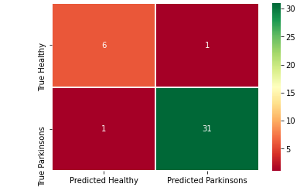
Heat Map
import seaborn as sns
sns.heatmap(a, cmap ='RdYlGn', linewidths = 0.30, annot = True)

Slide 30
Conclusion
Parkinson’s disease affects the CNS of the brain and it has no treatment yet detected early.
Late detection leads to no treatment and loss of life.
Early detection is very important.
For early detection of the disease , ML algorithms like XGBoost algorithms are employed.
XGBoost is the best algorithm to predict the onset of the disease which will enable early treatment and save a life.

